Slide 1


Towards Sustainable Cities: Design and Implementation of a Real-time Parking Slot Monitoring and Control System
GROUP MEMBERS:
NAME | ID
Mir Moahtasim Billah Soykot | 23-50442-1
Shahadat Hossain | 23-51341-1
Hamidul Islam | 23-50447-1
Md Sadek Hosen | 23-50435-1
Zahin Tahiat Annesha | 23-50414-1
PRESENTED TO:
Microprocessor And Embedded System
Section :G Group : 08
PROTIK PARVEZ SHEIKH

Slide 2
Abstract
Urbanization and rising car ownership increase parking problems
Traditional systems lack real-time parking information
Arduino-based system monitors parking spaces automatically
IR sensors detect vehicle entry and exit in real time
Reduces congestion and improves space utilization
Reliable performance with scope for future improvement

Slide 3
Introduction
Rapid urbanization increases parking demand
Lack of real-time parking information
Time loss and traffic congestion
Inefficient parking space utilization
Microcontroller-based real-time monitoring system
Improves parking efficiency and sustainability

Slide 4
Background to the Problem
Rapid urbanization and increasing car ownership are worsening parking congestion
Conventional parking systems lack real-time space availability information
Existing smart parking solutions are costly and difficult to scale
Many systems are unsuitable for resource-constrained environments
Poor integration with existing infrastructure limits practical adoption
A need exists for a low-cost, scalable, and easily deployable parking solution

Slide 5
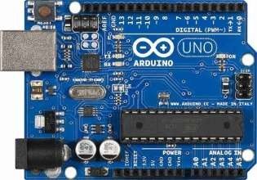
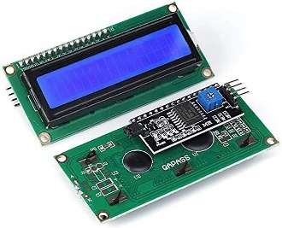
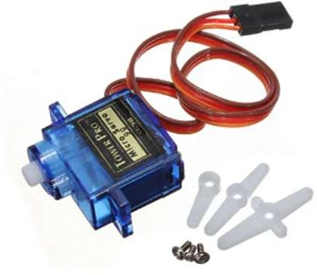
Equipment
Arduino Uno (microcontroller unit)
Servo Motor (gate control)
IR Sensors (vehicle detection)
I2C 16×2 LCD Display (status display)
Buzzer (alert/notification)
Connecting Wires (circuit connections)
Toy Car (vehicle simulation)

Slide 6
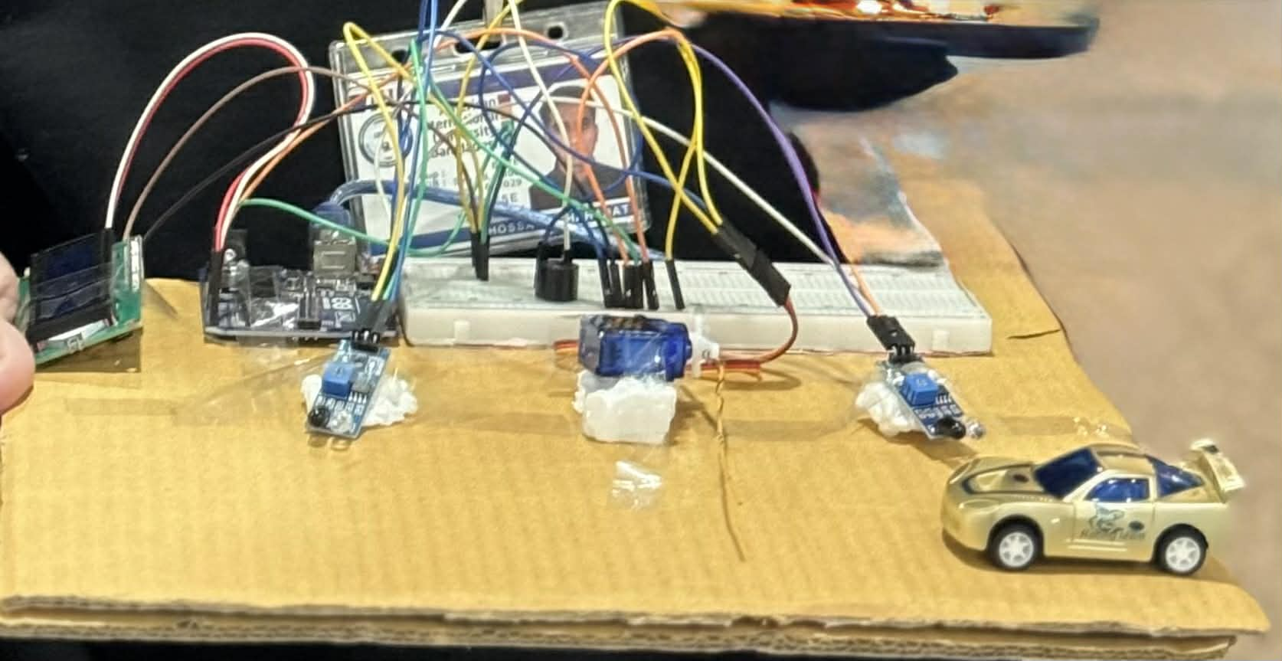
PROJECT DESCRIPTION
IR sensor detects vehicle at entry gate
Arduino checks parking space availability
Gate opens automatically if space is available
Slot status updates after vehicle entry or exit
LCD shows available and occupied slots in real time
Buzzer alerts and gate remains closed when full

Slide 7
Discussion
Simulation and experimental results confirm reliable real-time parking management
Ensured consistent vehicle detection
Servo motor enabled smooth and timely gate operation
LCD display provided accurate, real-time occupancy updates
Reduced parking search time and improved traffic flow
Low-cost prototype shows strong potential despite scalability and sensor limitations

Slide 8
Advantage
Provides real-time parking availability information
Reduces traffic congestion and parking search time
Low-cost and easy-to-implement system
Improves parking space utilization efficiency
User-friendly interface with clear visual alerts
Reliable performance with minimal human intervention

Slide 9
Limitations
Single entry/exit point may cause congestion
Limited scalability due to single Arduino UNO setup
No redundancy or fail-safe mechanism for sensor failure
Sensor range and accuracy limitations
Manual gate control in certain situations
No remote monitoring or control support

Slide 10
Future Work
Use of advanced sensors to improve accuracy and reliability
IoT integration for mobile and web-based monitoring
Scalability enhancements for large parking facilities
Integration with renewable energy and EV charging systems
Alignment with smart city and autonomous mobility platforms

Slide 11
Conclusion
Successfully designed a microcontroller-based smart parking system
Enables real-time parking availability and automatic gate control
Improves parking efficiency and overall traffic flow
Reduces user frustration and manual intervention
Demonstrates a practical, low-cost parking management solution

Slide 12
THANK YOU

